Slide 1
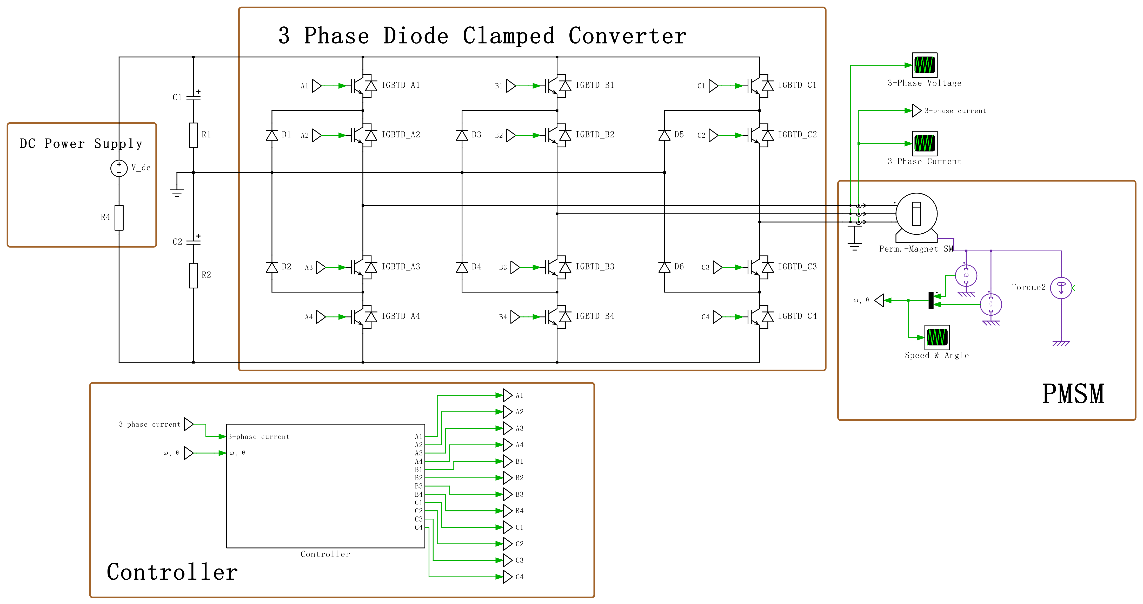
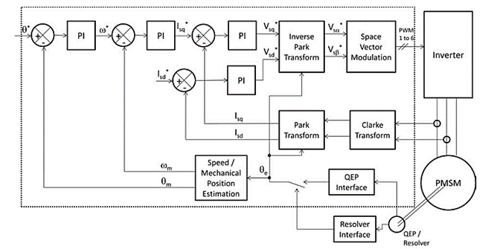
Diode Clamped Converter for Vehicle AC Machine Drive
Pengyuan Shu (20321149)
Circuit Topology
Control Diagram

Slide 2
Methods and Approach
No. | Goals and Processes | Challenges
1 | Read related resources to get familiar with the diode clamped converters and PMSM drives. | NA
2 | Select components according to the requirements (manufacturers can be Mouser, RS, Farnell…). The process is basically applying filter to exclude most irrelevant options, and compare those roughly fitted, then choose and order the best fit one (cheap / low loss / high tolerant…). | Some components might be unavailable / too expensive / take too long to ship
3 | Draw schematics based on selected components in KiCad, assign footprints to each component, and draw footprints that cannot found in the library. | Techniques for voltage balance between capacitors should be considered to prevent distortion.
4 | Plan PCB layout in KiCad, draw traces (ensure they are wide enough to handle large current) to connect components. Send project files to PCB factory for manufacturing. | Applying the design principles to reduce noise (should or should not use vias; thermal management on board; how to avoid ground bounce…)
5 | Whilst PCB is being manufactured, construct the diode clamped converter and the PMSM model in PLECS (fill up the parameters of PMSM simulation model according to the real machine model). | Mathematic modelling might be hard to implement; PMSM simulation model may not fit the real machine model well.
6 | Simulate the FOC algorithm and close the torque control loop in PLECS. Adjust the parameters to get expected output. | Implementation of FOC; Parameters of discrete PI controller might be difficult to tune.
7 | Further accomplish the speed and mechanical position closed loop control in PLECS. Adjust the parameters to get expected output. | Parameters tuning of discrete serial PI controller.
8 | Solder all the components to complete the converter construction and test it with DC power source. | Small surface mount package components might be hard to solder on pads.
9 | Use Code Composer Studio (CCS) and Digital Power SDK to construct the embedded C code to implement the control algorithm on MCU and validate simulation work with PCB connected to an RL load. | Task frequency will affect the parameters of PI controllers.
10 | Stretch target 1: Use the PCB to drive a low power PMSM motor with full FOC. | Realistic constrains of PMSM motor; Motor’s feedback data need to be logged and plotted.
11 | Stretch target 2: Design a Qt based human-machine interface (HMI) with a joystick for sending control commands to achieve torque / speed / mechanical position control of PMSM motor on a PC. | Delay might be occurred in data transmission, which will have negative impact on control.

Slide 3
Risk Table
Potential Risks | Mitigation Actions | Likelihood | Severity
PCB may not be manufactured as scheduled due to chip shortage or other unknown accidents. | Complete the schematic and PCB layout, then send them to factory for manufacturing early in the project. | Medium | High
Some key components are unavailable / shipping takes too long / too expensive. | Find alternatives, and identify those “long lead time” components | High | Low
The PCB may be damaged (e.g., burned), or contain a lot of noise interference due to design flaws. | Check the PCB layout with care (or ask supervisor for advice) before sending it to manufacture to prevent significant flaws. Adopt redundant design. Ensure the traces that can pass large current are wide enough. | Medium | High
Component size does not fit the package in the PCB. | Check the package size of each component before sending the PCB to manufacture. | Low | High
The performance of applied algorithm is less satisfactory. | Use MATLAB to evaluate the stability of the controller, modify it or adopt other controllers. | Medium | Medium

Slide 4
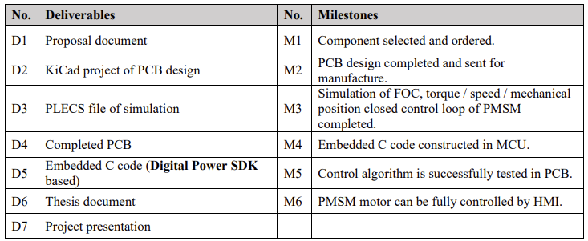
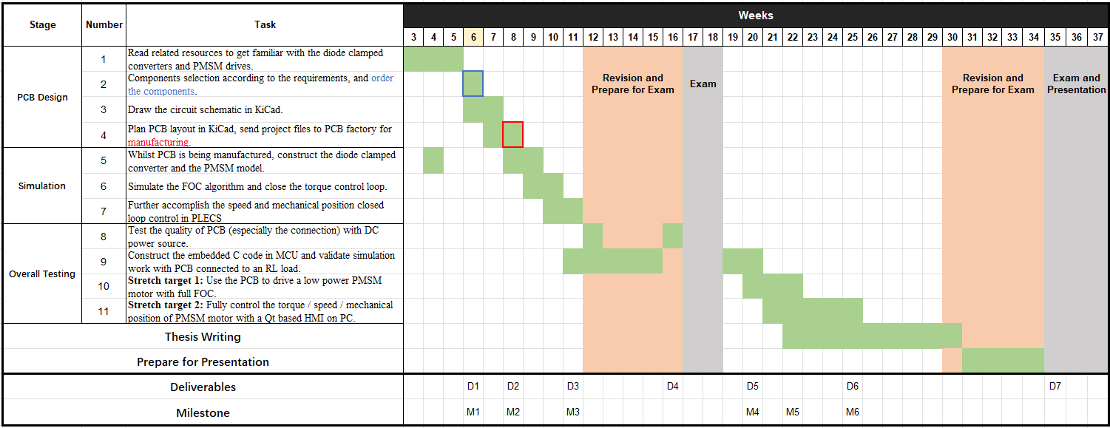
Time Plan

